Slide 1
Dependability and Security 2
Source of most materials:
Xiwei Xu, Ingo Weber, and Mark Staples. Architecture for Blockchain Applications. Springer, 2019

Slide 2
What will you learn?
Dependability and Security
Trust and the Need for Trustworthy Applications
Functionality
Security
Reliability

Slide 3
ISO/IEC 25010:2011 – Security Characteristics
Integrity
degree to which a system, product or component prevents unauthorized access to, or modification of, computer programs or data
Confidentiality
degree to which a product or system ensures that data are accessible only to those authorized to have access
Non-repudiation
degree to which actions or events can be proven to have taken place, so that the events or actions cannot be repudiated later
Accountability
degree to which the actions of an entity can be traced uniquely to the entity
Authenticity
degree to which the identity of a subject or resource can be proved to be the one claimed
(Privacy is controlling access to yourself; and not just information)
Only good writes & deletes
Only good reads
Undeniable
You did it!
Not fake

Slide 4
Non-Repudiation
ISO/IEC 25010:2011: “degree to which actions or events can be proven to have taken place, so that the events or actions cannot be repudiated later”
Main support is from blockchain’s immutable ledger
But be careful of probabilistic immutability in Nakamoto consensus; use the right number of confirmation blocks for your application’s risk profile
Some support from public key signatures for transactions
Just because data is recorded on-chain, doesn’t mean it’s true!
Someone might have stolen my private key?
Sender might have fraudulently recorded false data in a transaction
Blockchain only provides non-repudiation that the transaction happened
If using hashes on-chain for off-chain data, need to retain original data

Slide 5
Accountability
ISO/IEC 25010:2011: “degree to which the actions of an entity can be traced uniquely to the entity”
Main support in blockchain platforms is from cryptographically-signed transactions
Does a single entity control the signing key? Good key management is critical!
Most public blockchains try to directly stop this
Pseudonymous IDs are too weak to
New privacy coins (Zcash, Dash, Monero, …) try to provide anonymity like cash
KYC/AML-CTF
“Know Your Customer”/ “Anti-Money Laundering, Counter-Terrorism Financing”
e.g. Australian AUSTRAC regulation requires KYC/AML by crypto-currency exchanges
Private blockchains are normally permissioned, and users’ identities known
Authentication requires off-chain mechanisms to establish identity
Blockchain can be used to communicate or ensure integrity of KYC information

Slide 6
Authenticity
ISO/IEC 25010:2011: “degree to which the identity of a subject or resource can be proved to be the one claimed”
Major issue in supply chain, e.g. is this real Australian baby formula?
Many blockchain applications are trying to improve supply chain quality
For physical assets, hard to guarantee, unless a unique physical “fingerprint”
e.g. diamonds, DNA?
Attacks include fake duplicate labels, substitution in (or reuse of) original packaging
Need a way of comparing blockchain record to the physical item
For digital assets, much easier on blockchain!
Put authoritative register on blockchain, or have an off-chain authority sign the assets

Slide 7



Student Task
For the case of exam registration, how important are the security characteristics as per ISO/IEC 25010:2011?
Think about for 1 minute
List of security characteristics:
Integrity
Confidentiality
Non-repudiation
Accountability
Authenticity

Slide 8
Reliability

Slide 9
ISO/IEC 25010:2011 – Reliability Characteristics
Reliability
degree to which a system, product or component performs specified functions under specified conditions for a specified period of time
Availability
degree to which a system, product or component is operational and accessible when required for use
Recoverability
degree to which, in the event of an interruption or a failure, a product or system can recover the data directly affected and re-establish the desired state of the system
Maturity
degree to which a system, product or component meets needs for reliability under normal operation
Fault-Tolerance
degree to which a system, product or component operates as intended despite the presence of hardware or software faults

Slide 10
Availability
ISO/IEC 25010:2011: “degree to which a system, product or component is operational and accessible when required for use”
A measure could be something like “probability of being able to provide service at any given time”
Affected by the other reliability characteristics, such as probability of failure, fault tolerance, time to recovery, etc
Blockchain systems are often highly redundant (many nodes)
Easy to subscribe to updates / to get replicas of the ledger
An application can run many redundant blockchain nodes locally → high read availability
Write availability is a different story…

Slide 11
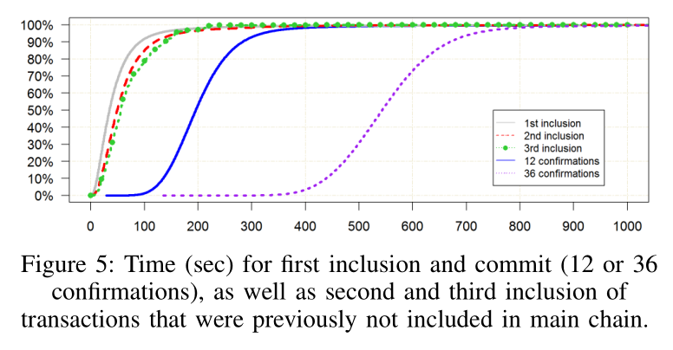
Latency Variability Can Limit Write Availability
Scenario
your application sends a transaction to update blockchain ledger
waiting… waiting…
? should I keep waiting? or was there a service failure? (i.e. an availability problem)
You will define some limit on your waiting time
Long tail of variability in latency means sometimes it will take even longer
But, by then your application will have decided a failure has happened
Complex trade-off:
Availability vs. Cost (gas/fee) vs. Latency (# confirmations) vs. Risk (# confirmations)
Mainly a problem with public blockchains?
(Depending on consensus mechanism, mining node policies, etc.)
“On availability for blockchain-based systems,” SRDS 2017 https://ieeexplore.ieee.org/document/8069069

Slide 12
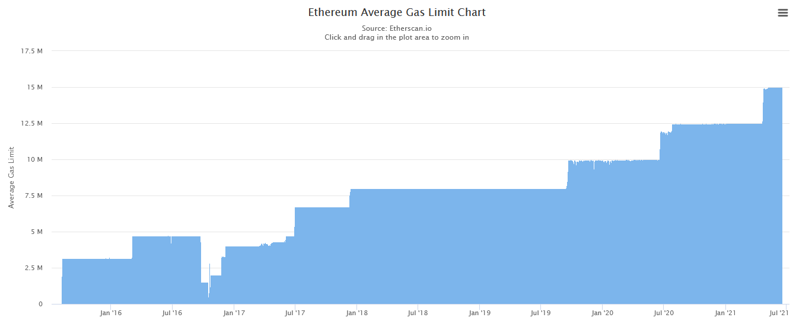
Availability (SRDS 2017)
Potential issue: block gas limit (≈size of a block on Ethereum)
Gas limit is set by miners through “voting”
The sum of gas of all transactions in a block must be less than the limit
Response to DDoS attack: lower block gas limit
https://etherscan.io/chart/gaslimit
Visited at 18/06/21

Slide 13
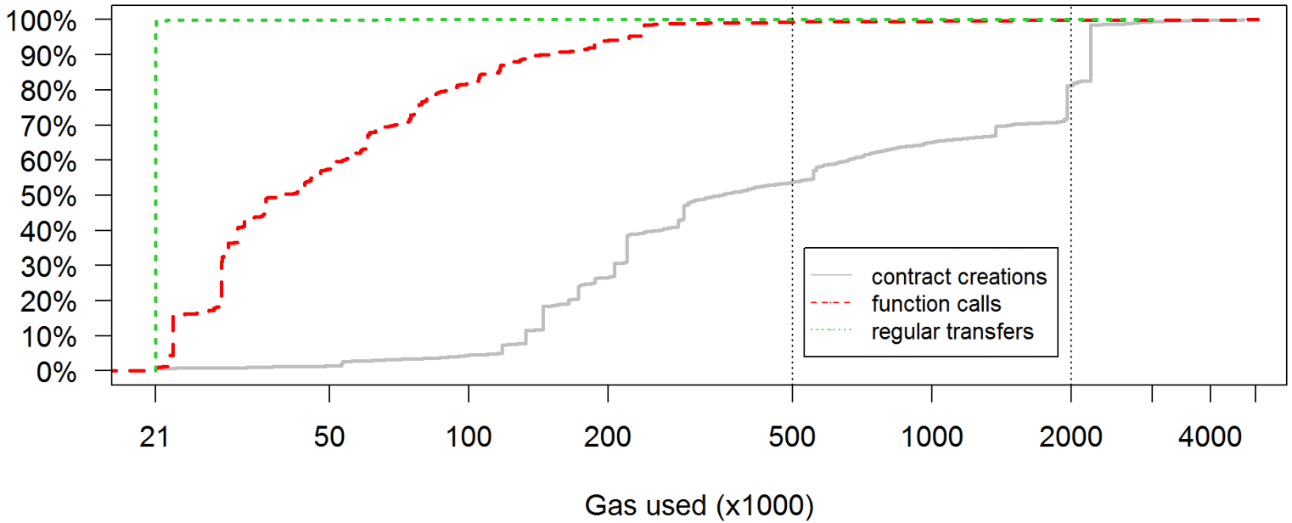
Availability (SRDS 2017)
Potential issue: block gas limit (≈size of a block on Ethereum)
Gas limit is set by miners through “voting”
The sum of gas of all transactions in a block must be less than the limit
Response to DDoS attack: lower block gas limit
Who would be affected by that?

Slide 14
Availability for Blockchain-Based Applications
A blockchain-based application has many components
Even if the blockchain platform works, your other components may fail
Use normal availability-increasing design strategies for the architecture, for example…
Increase quality of each component & connector
High quality software and hardware (!)
Eliminate single points of failure/ increase redundancy
Load balancing/failover monitoring and routing
Stateless server components
Blockchain can help enable “stateless” server component (use blockchain to store the state)
Detect and recover from failures
Hot backup/failover servers

Slide 15
Recoverability
ISO/IEC 25010:2011: “degree to which, in the event of an interruption or a failure, a product or system can recover the data directly affected and re-establish the desired state of the system”
Blockchain platform is likely to recover – consensus mechanisms are designed to autonomously recover ledger consistency and adapt to node loss
In worst case in a public blockchain, there might be a hard fork in the ledger
Normally, recoverability will mostly be a concern for other parts of the application architecture
But, can you abort a blockchain transaction, to safely retry?
Most blockchains do not explicitly provide support for this!

Slide 16
How to Abort a Transaction in Ethereum?
If you send a transaction into the pool, and it’s not yet included, can you abort it?
You’ve changed your mind, or something is wrong, or taking too long to commit
Ethereum transactions have a nonce, normally increment per transaction
Miners will consider a Tx with an old or reused nonce as being “outdated”
Issue a competing null transaction with same address & transaction nonce, with a higher fee
e.g. send 0 Ether to yourself, or invoke a smart contract to raise an exception
Reissue the “same” transaction from same address & nonce, with a higher fee
Higher fee means it has different hash value, so will be seen as “different”
(If you keep everything the same, it won’t be processed as a new Tx)

Slide 17
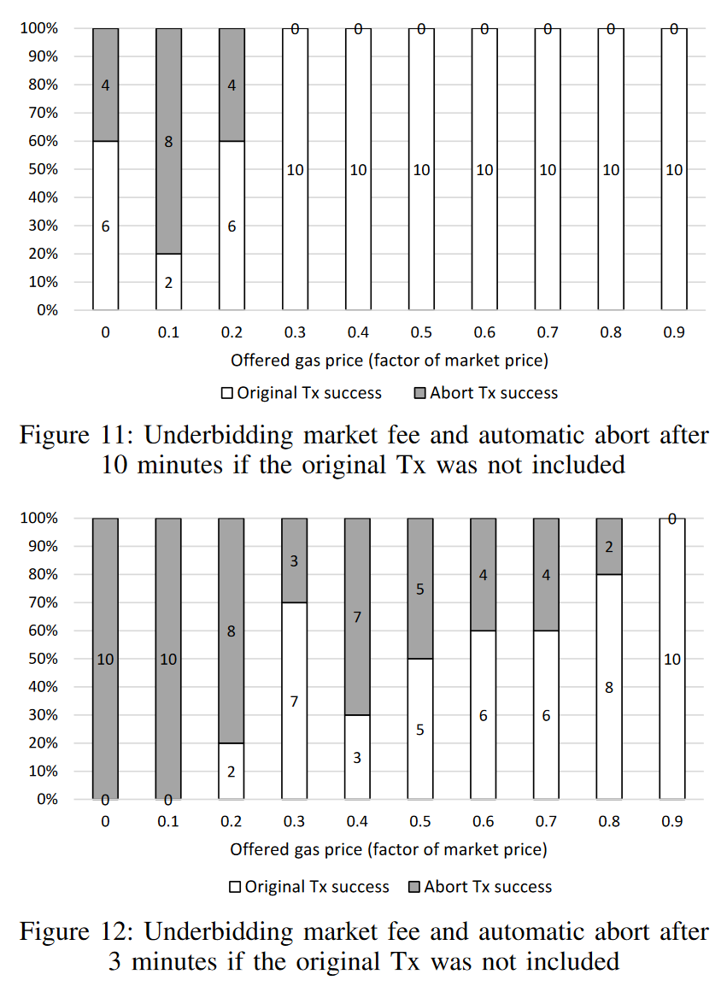
Does Transaction Aborting in Ethereum Work?
It’s not guaranteed to work
This trick creates a race condition; either transaction in the pool might get included
Depends on not just the fee for the new transaction, but also the fee for the initial transaction
“On availability for blockchain-based systems,” SRDS 2017 https://ieeexplore.ieee.org/document/8069069

Slide 18
Maturity (“Reliability”)
ISO/IEC 25010:2011: “degree to which a system, product or component meets needs for reliability under normal operation”
My opinion: not a great name for this…
Availability is about readiness for correct service
vs.
Reliability is about continuity of correct service
Previous discussion about availability for blockchain-based applications applies here too

Slide 19
Fault-Tolerance
ISO/IEC 25010:2011: “degree to which a system, product or component operates as intended despite the presence of hardware or software faults”
Blockchain platform tolerates faults
Hardware faults in individual miners: other miners will keep working
Software faults too, if there is enough diversity of mining software
In worst case, might get a hard fork
For blockchain applications
Use normal design strategies for fault tolerance (redundancy, monitor, detect, isolate, recover) for other parts of the architecture
Smart contracts are not normally fault-tolerant for software faults
Smart contracts can be used for fault tolerance logic for off-chain components…

Slide 20
Oracle Faults
Can use on-chain M-of-N voting for redundant oracles
Client
Blockchain
Oracle
Sensor
Oracle
Sensor
Blockchain
Client
Comparator Smart Contract
Oracle
Sensor
Oracle
Sensor

Slide 21
Student Task
For the case of exam registration, how important are the reliability characteristics as per ISO/IEC 25010:2011?
Think about for 1 minute
List of reliability characteristics:
Availability
Recoverability
“Maturity” / Reliability: continuous service
Fault Tolerance

Slide 22
Summary

Slide 23
Blockchains as Dependable Systems
Trust – accepted dependence and risk
Trustworthy – justified Trust
Need Evidence to justify Engineering Assurances
Validation
Sort-of-but-not-quite: “am I solving the right problem?”
Does my requirements/specification/system/design address/solve the user problem?
Verification
Sort-of-but-not-quite: “am I solving the problem right?”
Does my system/design meet the requirements specification?
Can provide evidence based on architectural analysis, early in the lifecycle
Blockchains are increasingly relied on; need evidence they are trustworthy

Slide 24
ISO/IEC 25010:2011 Dependability & Security
Functional Suitability
Correctness
Completeness
Appropriateness
Code is Not Law
How to specify smart contracts?
Security
Integrity & Clark-Wilson policy model
Blockchain “anomaly” in Nakamoto consensus: possible transaction reordering
Confidentiality
and difference to Privacy
Non-Repudiation
Accountability
avoid or support? KYC/AML-CTF
Authenticity
Reliability
Availability: readiness for service
Affected by latency variability
Recoverability
Aborting transactions
“Maturity”
Reliability: continuous service
Fault Tolerance
Use of smart contracts for redundant oracles

Slide 25
Dependability and Security 2
Source of most materials:
Xiwei Xu, Ingo Weber, and Mark Staples. Architecture for Blockchain Applications. Springer, 2019

